Slide 1
Working with ADO.NET

Slide 2
Agenda
ADO.NET Overview
The Connected Layer
The Disconnected Layer
Q&A

Slide 3
ADO.NET Overview
What is ADO.NET?
Overall architecture of ADO.NET
ADO.NET Data Providers
ADO.NET Core Objects

Slide 4
What is ADO.NET?
  ADO.NET is a collection of classes, interfaces, enums, structures, and delegates that manage data access from relational data stores within the .NET Framework
  ADO.NET is an evolution from ADO(ActiveX Data Objects)
  Designed for highly efficient data access
Support for XML and disconnected record sets

Slide 5
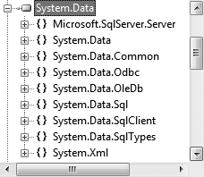
What is ADO.NET?(cont.)
  System.Data.dll is the core ADO.NET assembly

Slide 6
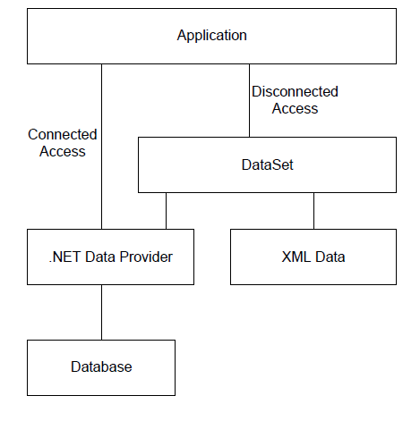
Overall architecture of ADO.NET

Slide 7
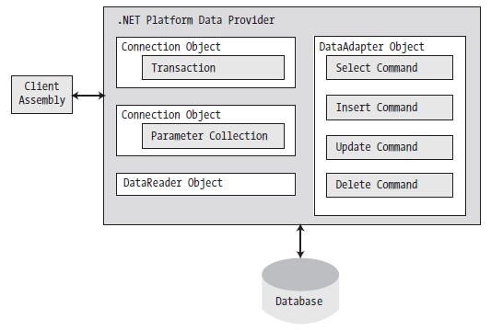
ADO.NET Data Providers

Slide 8
ADO.NET Core Objects
  Connection:
  Provides the ability to connect to and disconnect from the data store.
  Command
  Represents a SQL query or a stored procedure.
  Data Reader
  Provides forward-only, read-only access to data using a server-side cursor.
  Data Adapter
  Transfers DataSets between the caller and the data store.
  Parameter
  Represents a named parameter within a parameterized query
  Transaction
  Encapsulates a database transaction

Slide 9
Agenda
ADO.NET Overview
The Connected Layer
The Disconnected Layer
Q&A

Slide 10
The Connected Layer
Working with Connection
Working with DataReader
Working with Command
Working with Transaction

Slide 11
Working with Connection
  Using SqlConnection
  Connection string parameters
string strConn = "data source=localhost; " +
"initial catalog=northwind; integrated security=true";
SqlConnection conn = new SqlConnection(strConn);
Use Window authentication
Data source
Initial catalog
Integrated security = true
Use SQL Server Authentication
Data source
Initial catalog
User ID
Password

Slide 12
Working with Connection(cont.)
  Connection Pooling
  Min Pool Size
  Max Pool Size
  Connection Lifetime : When a connection is returned to the pool, its creation time is compared with the current time, and the connection is destroyed if that time span (in seconds) exceeds the value specified by Connection Lifetime.
  Connection Timeout: The length of time (in seconds) to wait for a connection to the server before terminating the attempt and generating an error.

Slide 13
Working with DataReader
  Connect to a database and read the records using a data reader object.
    Allocate, configure, and open your connection object.
    Allocate and configure a command object, specifying the connection object as a constructor argument or via the Connection property.
    Call ExecuteReader() on the configured command object.
    Process each record using the Read() method of the data reader.

Slide 14
Working with DataReader - Example
// Create an open a connection.
SqlConnection cn = new SqlConnection();
cn.ConnectionString =
@"Data Source=(local)\SQLEXPRESS;Integrated Security=SSPI;" + "Initial Catalog=AutoLot";
cn.Open();
// Create a SQL command object.
string strSQL = "Select * From Inventory";
SqlCommand myCommand = new SqlCommand(strSQL, cn);
// Obtain a data reader by ExecuteReader().
SqlDataReader myDataReader;
myDataReader = myCommand.ExecuteReader(CommandBehavior.CloseConnection);

Slide 15
Working with DataReader - Example(cont.)
// Loop over the results.
while (myDataReader.Read())
{
  Console.WriteLine("-> Make: {0}, PetName: {1}, Color: {2}.",
  myDataReader["Make"].ToString().Trim(),
  myDataReader["PetName"].ToString().Trim(),
  myDataReader["Color"].ToString().Trim());
}
// Because we specified CommandBehavior.CloseConnection, we
// don't need to explicitly call Close() on the connection.
myDataReader.Close();
Console.ReadLine();

Slide 16
Reading Data from a DataReader
  Call Read for each record
    Returns false when there are no more records
  Access fields
    Parameter is the ordinal position or name of the field
    Get functions give best performance
  Close the DataReader
  Close the connection
while (myReader.Read())
{
str += myReader[1];
str += myReader["field"];
str += myReader.GetDateTime(2);
}

Slide 17
Working with Command
ExecuteReader(): Returns the data provider’s DbDataReader object, which provides forwardonly, read-only access to the underlying data.
  ExecuteNonQuery() - used for Insert, Update, Delete SQL statement, returns number of Rows Affected
  ExecuteXMLReader() - Returns XMLReader Object to Read XML documentation
  ExecuteScalar() - Returns a Single Value e.g. SQL SUM function.

Slide 18
Working with Transaction
  // Create command objects that represent each step of the operation.
  SqlCommand cmdRemove = new SqlCommand(“Delete from Customers…”, sqlCn);
  SqlCommand cmdInsert = new SqlCommand(“Insert Into CreditRisks”, sqlCn);
  // We will get this from the connection object.
  SqlTransaction tx = null;
  try
  {
  tx = sqlCn.BeginTransaction();
  // Enlist the commands into this transaction.
  cmdInsert.Transaction = tx;
  cmdRemove.Transaction = tx;
  // Execute the commands.
  cmdInsert.ExecuteNonQuery();
  cmdRemove.ExecuteNonQuery();
  tx.Commit();
  }
  catch (Exception ex)
  {
  // Any error will roll back transaction.
  tx.Rollback();
  }

Slide 19
Using Transaction Scope
Use TransactionScope to maintain one transaction for multiple databases or a single database with multiple connectionstrings.
  using (TransactionScope transactionScope = new TransactionScope())
  {
  try
  {
  method1() // Oracle DML operation
  method2() // Sql DML operation
  method3() // Oracle DML operation
  transactionScope.Complete()
  transactionScope.Dispose();
  }
  catch (TransactionException ex)
  {
  transactionScope.Dispose();
  MessageBox.Show("Transaction Exception Occured");
  }
  }

Slide 20
Using Transaction Scope(cont.)
string connectionString = ConfigurationManager.ConnectionStrings["db"].ConnectionString;
var option = new TransactionOptions
{
IsolationLevel = IsolationLevel.ReadCommitted,
Timeout = TimeSpan.FromSeconds(60)
};
using (var scopeOuter = new TransactionScope(TransactionScopeOption.Required, option))
{
using (var conn = new SqlConnection(connectionString))
{
using (SqlCommand cmd = conn.CreateCommand())
{
cmd.CommandText="INSERT INTO Data(Code, FirstName)VALUES('A-100','Mr.A')";
cmd.Connection.Open();
cmd.ExecuteNonQuery();
}
}

Slide 21
Using Transaction Scope(cont.)
using (var scopeInner = new TransactionScope(TransactionScopeOption.Required, option))
{
using (var conn = new SqlConnection(connectionString))
{
using (SqlCommand cmd = conn.CreateCommand())
{
cmd.CommandText="INSERT INTO Data(Code, FirstName) VALUES('B-100','Mr.B')";
cmd.Connection.Open();
cmd.ExecuteNonQuery();
}
}
scopeInner.Complete();
}
scopeOuter.Complete();
}
* TransactionScopeOption.Required: Outer transaction is committed then the inner transaction will commit. If the outer transaction is rolled back, then the inner transaction will be rolled back.
* TransactionScopeOption.RequiredNew : A new transaction will be created and this transaction will independently be committed or rolled back

Slide 22
Agenda
ADO.NET Overview
The Connected Layer
The Disconnected Layer
Q&A

Slide 23
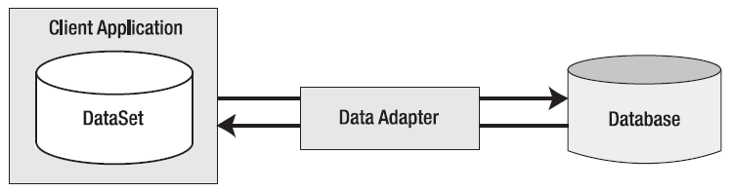
Data adapter
Data adapter objects move DataSets to and from the client tier

Slide 24
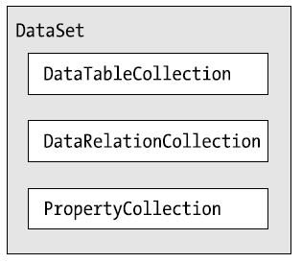
DataSets
  DataSet is an in-memory representation of relational data
Operations are performed on the DataSet, not the data source

Slide 25
DataSets(cont.)
  The DataTableCollection contains all the DataTable objects for a particular DataSet. To access use Tables property.
  The DataRelationCollection contains parent/child relationships between its tables. To access use the Relations property of the DataSet object.
  The PropertyCollection contains a collection of properties that can be added to DataColumn, DataSet, or DataTable.

Slide 26
DataAdapters
  Pipeline between DataSets and data sources
  Geared towards functionality rather than speed
  Disconnected by design
  Supports select, insert, delete, update commands and methods

Slide 27
Using the DataAdapter
SQLDataAdapter sqlDA = new SqlDataAdapter();
sqlDA.SelectCommand =
new SqlCommand ("select * from authors“, sqlConnection);
DataSet sqlDS = new DataSet("authorsTable");
sqlDA.Fill(sqlDS, "authorsTable");

Slide 28
Using the DataAdapter(cont.)
string updateSQL = @"update employee set firstname = @firstname where id=@id";
SqlConnection conn = new SqlConnection(connString);
SqlDataAdapter da = new SqlDataAdapter();
// Update employees
SqlCommand cmd = new SqlCommand(updateSQL, conn);
cmd.Parameters.Add("@firstname",SqlDbType.NVarChar,15, "firstname");
SqlParameter parm = cmd.Parameters.Add("@id",SqlDbType.Int,4,"id");
parm.SourceVersion = DataRowVersion.Original;
da.UpdateCommand = cmd;
da.Update(ds, "employee");

Slide 29
References
Pro C# 2008 and the NET 3.5 Platform Fourth Edition by Andrew Troelsen

Slide 30
Q&A
Question & Answer
Notes:
http://msdn.microsoft.com/en-us/data/dd363565.aspx

